Slide 1
Shifted Binary Search
2023/02/04
Hailey

Slide 2
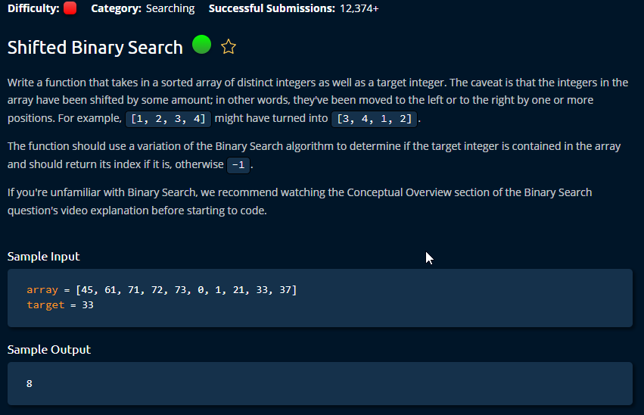

Slide 3
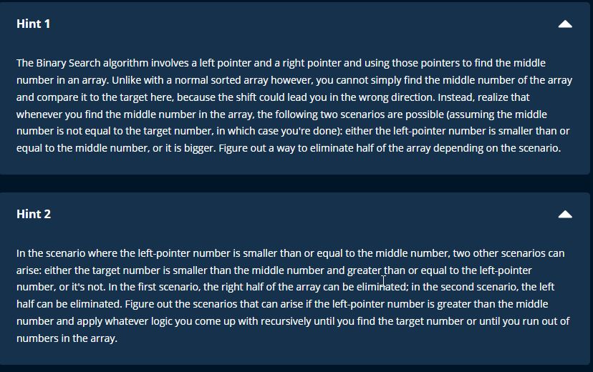

Slide 4
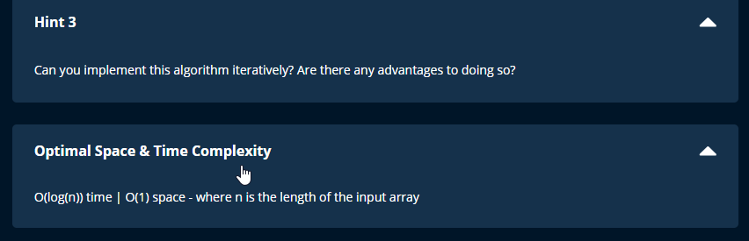

Slide 5
Steps
The most important fact is understand is that the sequence is still sorted but shifted a little bit.
For eg. [0,1,2,3,4,5,7,8] → [7,8,0,1,2,3,4,5]
So, we can still apply the concept at binary search.
The only difference is after taking the middle point, only one side of the array is sorted.
Try to use this sorted side or eliminate it .

Slide 6
